Slide 1
Data base management SYSTEM (15ECSC208) Team id:- 4D16 Category: Explorative Project Title: Image Caption Generator List of Team Members: Abbasali A Jamadar (USN: 01FE20BCS414 Roll No: 466) Neha Kardant (USN: 01FE20BCS422 Roll No: 469) Nihal Fernandis (USN: 01FE19BCS237 Roll No: 437)

Slide 2
Responsibilities: Abbasali A Jamadar: Working on CNN, LSTM, CV, NLP, tensorflow, Datasets,codding Neha Kardant: Working on CNN, LSTM, CV, NLP, Datasets, some part of the code Nihal Fernandis: Working on CNN, LSTM, CV, NLP, Datasets Note: Study of libraries in the above given responsibilities is specifically related to our course project only.

Slide 3
Building the Python based Project
We start by initializing the jupyter notebook server by typing jupyter lab in the console of our project folder. It will open up the interactive Python notebook where we can run your code. Create a Python3 notebook and name it training_caption_generator.ipynb
1. First, we import all the necessary packages
2. Getting and performing data cleaning:-
The main text file which contains all image captions is Flickr8k.token in our Flickr_8k_text folder.

Slide 4
3. Extracting the feature vector from all images This technique is also called transfer learning, we don’t have to do everything on our own, we use the pre-trained model that have been already trained on large datasets and extract the features from these models and use them for our tasks. We are using the Xception model which has been trained on imagenet dataset that had 1000 different classes to classify. We can directly import this model from the keras.applications . Make sure you are connected to the internet as the weights get automatically downloaded. Since the Xception model was originally built for imagenet, we will do little changes for integrating with our model. One thing to notice is that the Xception model takes 299*299*3 image size as input. We will remove the last classification layer and get the 2048 feature vector. 4. Loading dataset for Training the model In our Flickr_8k_test folder, we have Flickr_8k.trainImages.txt file that contains a list of 6000 image names that we will use for training.

Slide 5
5. Tokenizing the vocabulary Computers don’t understand English words, for computers, we will have to represent them with numbers. So, we will map each word of the vocabulary with a unique index value. Keras library provides us with the tokenizer function that we will use to create tokens from our vocabulary and save them to a “tokenizer.p” pickle file. 6. Create Data generator Let us first see how the input and output of our model will look like. To make this task into a supervised learning task, we have to provide input and output to the model for training. We have to train our model on 6000 images and each image will contain 2048 length feature vector and caption is also represented as numbers. This amount of data for 6000 images is not possible to hold into memory so we will be using a generator method that will yield batches.

Slide 6
7. Defining the CNN-RNN model To define the structure of the model, we will be using the Keras Model from Functional API. It will consist of three major parts: Feature Extractor – The feature extracted from the image has a size of 2048, with a dense layer, we will reduce the dimensions to 256 nodes. Sequence Processor – An embedding layer will handle the textual input, followed by the LSTM layer. Decoder – By merging the output from the above two layers, we will process by the dense layer to make the final prediction. The final layer will contain the number of nodes equal to our vocabulary size.

Slide 7
8. Training the model To train the model, we will be using the 6000 training images by generating the input and output sequences in batches and fitting them to the model using model.fit_generator() method. We also save the model to our models folder. This will take some time depending on your system capability. 9. Testing the model The model has been trained, now, we will make a separate file testing_caption_generator.py which will load the model and generate predictions. The predictions contain the max length of index values so we will use the same tokenizer.p pickle file to get the words from their index values.

Slide 8
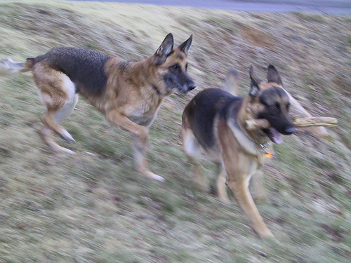
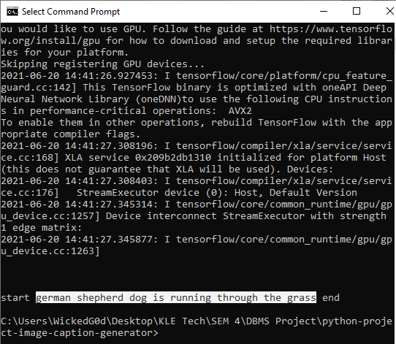
Results:

Slide 9
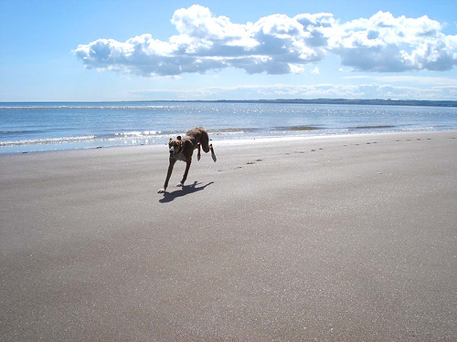
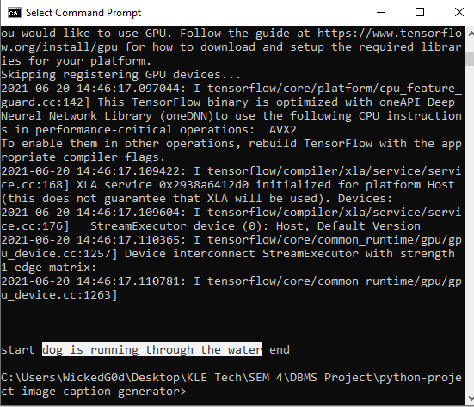
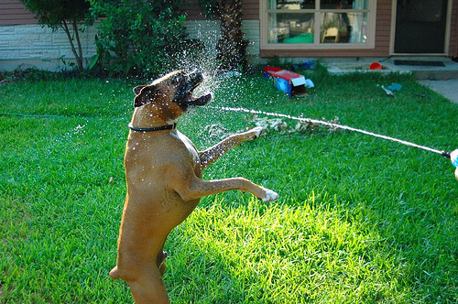
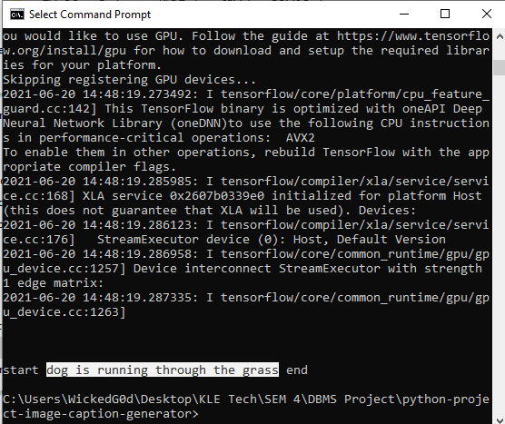

Slide 10
References:
Flicker8k_Dataset: https://www.kaggle.com/ming666/flicker8k-dataset
Flciker_8k_text: https://www.kaggle.com/ming666/flicker8k-dataset
CNN: https://data-flair.training/blogs/convolutional-neural-networks-tutorial/
For some ideas, went through Github and other websites.

